Slide 1
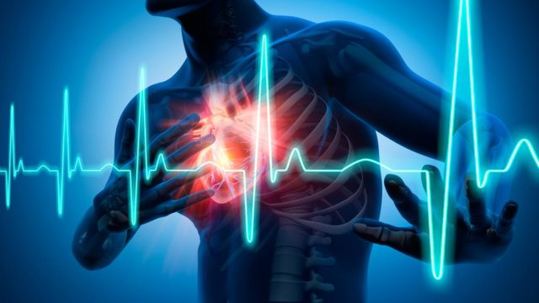
Heart Attack Prediction Analysis
By Theo, Eunice, Islom

Slide 2
Heart Attack
Heart attack, also called a myocardial infarction, can be fatal and can lead to death
It occurs when the flow of blood to the heart is blocked.
The blockage is most often a build-up of fat, cholesterol and other substances, which form a plaque in the arteries that feed the heart (coronary arteries).

Slide 3
Goal of the project
Treament for heart attack as improved dramatically over the years. Hence, our goal is to:
Build and train a machine learning model that is able to accurately predict the chances of a person having and heart attck or not.
Build a cli that is able to get data from a monitoring system and make predictions based on the model.
With this prediction the person knows his/her chances of having an attck and use the drugs just before the attck occurs

Slide 4
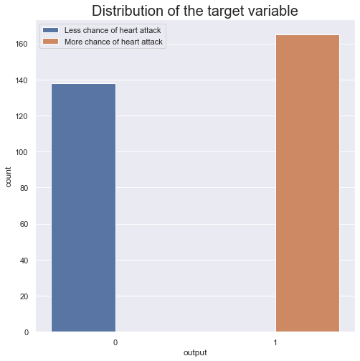
Over view of Data set
About 165 people in the data had chances of getting heart attack while about 140 had less chance

Slide 5
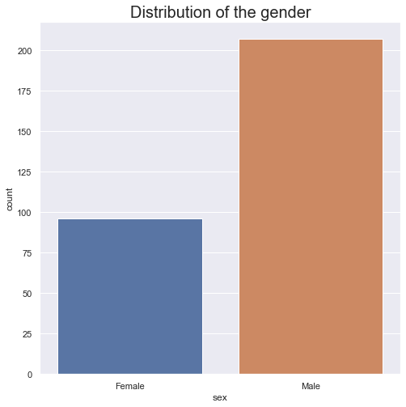
The dataset contains mostly males

Slide 6
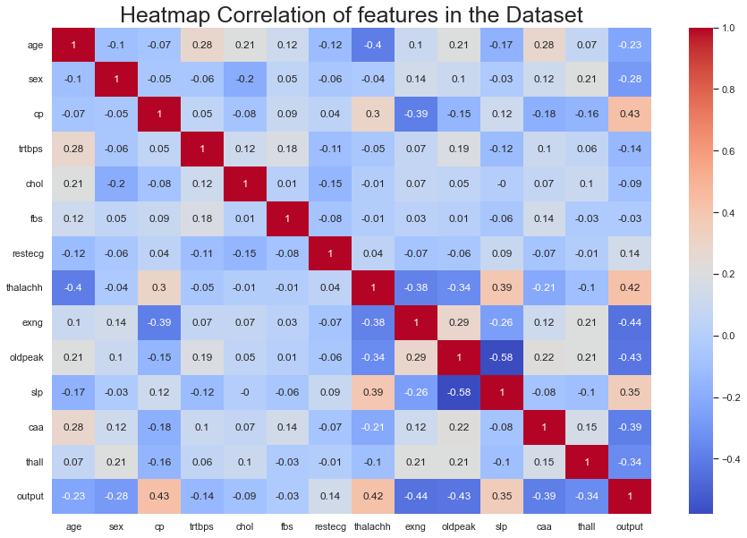

Slide 7
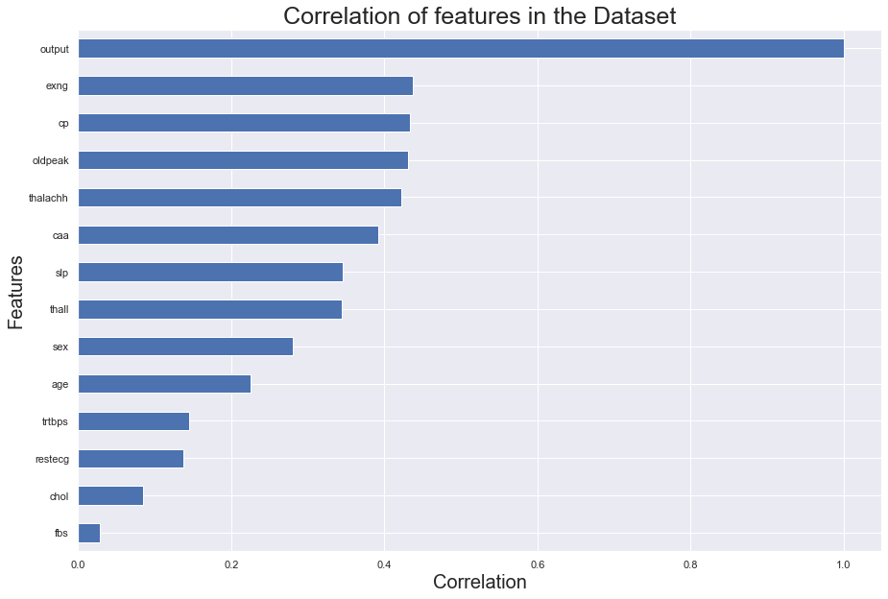

Slide 8


